Slide 1

بنيان Bunyan

Slide 2

Project Objectives
Key Objectives of the Project
The main objectives include financial tracking, monitoring project milestones, enhancing communication among stakeholders, and reducing risks through systematic oversight.
Photos provided by Unsplash

Slide 3
Stakeholders Involved
This table lists key stakeholders in the construction project, their roles, and responsibilities, enhancing collaboration and accountability.
Stakeholder | Role | Responsibilities
Project Owner | Provides funding | Sets project objectives and timelines
Contractor | Executes the project | Supervises construction and coordinates subcontractors

Slide 4
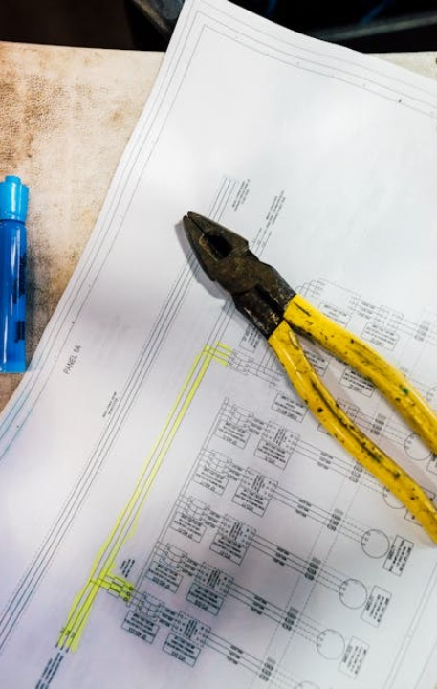
Process Overview
Contractor's Duties
Owner's Responsibilities
The contractor handles daily operations, follows safety regulations, and reports any issues to the project owner for resolution.
The project owner defines the project scope, approves budgets, and monitors progress to ensure it aligns with objectives.
Photos provided by Unsplash

Slide 5
Expected Outcomes
%50
%30
%20
Efficiency Gains
Financial Benefits
Positive Feedback
Improved tracking leads to faster issue resolution and better resource allocation.
Tracking system reduces over-expenditure through timely monitoring.
Enhanced communication and project visibility lead to higher satisfaction among stakeholders.

